Slide 1
Lecture 1: Introduction
Models of the motor system
2025-2
Opher Donchin
E-mail: donchin@bgu.ac.il
Notes:
Hello and welcome to

Slide 2
Welcome and Course Essentials
Do you belong here?
Are you interested in how our brains create our movements?
Do you know:
Basic math: linear algebra, differential equations
Basic Python programming
Scientific English: Can you read papers?
Basics of neuroscience: What is a neuron? Where is the brain?
Do I belong here?
Opher Donchin
Motor control, motor learning, cerebellum, models

Slide 3
The course
Special thanks to Dr. John Cashaback
https://bme.udel.edu/people/joshua-cashaback-ph-d/
https://joshcashaback.weebly.com
University of Delaware, Biomedical Engineering
This course based on his course
Neuromechanics
https://github.com/joshcash9/Neuromechanics_Course

Slide 4
Topics (and models)
Muscles in motor control
Models of the muscle
Movements
Invariants of Motor models
Equations of motion
Sensory systems in motor control
Models of sensorimotor integration
Motor learning
Learning from errors and rewards
Complex models
Optimal control model
Multi-state model
Today’s focus:
Why study motor learning and motor control?
What is a model?
Overview of the motor brain

Slide 5

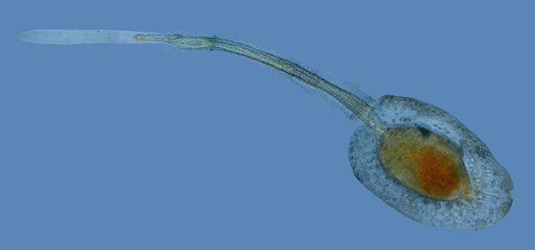
Why motor system?
The nervous system evolved for movement
Animals that don’t move don’t need brains
Movement requires telereceptors (eyes, nose, ears)
Telereceptors require:
Body organization
Centralized, unified processing
Adult sea squirt (1-10 cm)
Sea squirt larva (1 mm)

Slide 6
Why motor learning?
The motor system is highly plastic
Each movement changes the next movement
Movements constantly adapting
Always learning new movements
Learning is the brain’s second core advantage
After coordinated movement!
Motor learning offers powerful tools for modeling and engineering
Perturbation analysis
System identification

Slide 7
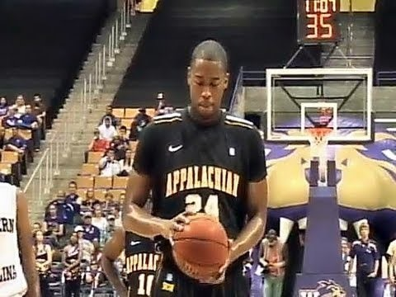
Noise in the motor system
No matter how good we get, our movements are variable!
https://www.youtube.com/embed/8dLx53NanQ0

Slide 8
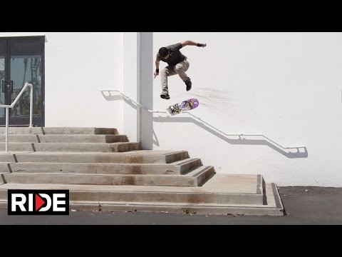
Learning in the motor system
In a complicated system, it can be hard to know what to change
https://www.youtube.com/embed/S9KE2R92pSg

Slide 9
What is a model?
A collection of equations
Expressing a theory about how the world works
How do we combine different sense?
How do muscles turn neural signals into force?
How do we change our movements when we make errors?

Slide 10
What is a model?
A collection of equations
Expressing a theory about how the world works
With parameters:
Things we can’t measure
Confidence in our different senses
Feedback amplification of muscles
Internal state of the motor plans

Slide 11
What is a model?
A collection of equations
Expressing a theory about how the world works
With parameters
And outputs
Things we can measure
Movement direction
Reaction time
Force
And inputs
Things that come in from outside

Slide 12
What is a model?
A collection of equations
Expressing a theory about how the world works
With parameters
And outputs
And inputs
Outputs
Inputs
Model
Theory + Parameters

Slide 13
Why models?
Express our understanding
A model reflect how we believe the system works

Slide 14
Why models?
Express our understanding
Make our claims precise
Models make specific predictions

Slide 15
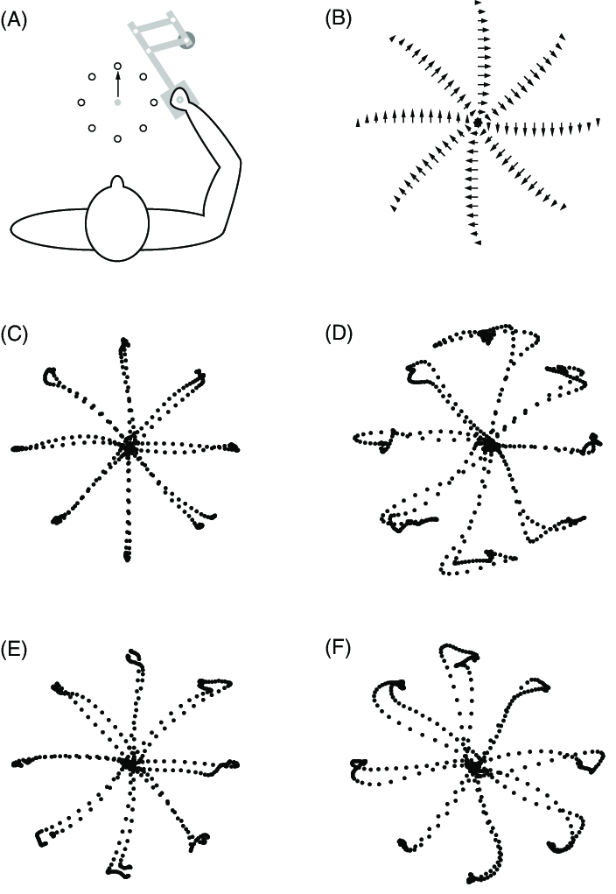
Why models?
Express our understanding
Make our claims precise
Expose our limitations
Identify where real behavior deviates from predictions
Example: Reaching in a force field
Model:
Linear dynamical model that incorporates forces and sensory feedback
Prediction:
Exposure to perturbing force field perturbing causes predictable deviation
Test:
Compare predicted trajectories to actual subject data and refine model

Slide 16
The dangers of modeling
All models are:
Too simple
Too complex
Wrong
A model should be as simple as possible and as complex as necessary!
A model should generalize!

Slide 17
Connections
Neuroprosthetics
Brain-machine interface
Man-machine interactions
Prosthetics and exoskeletons
Rehabilitation and physiotherapy
Training and athletics

Slide 18
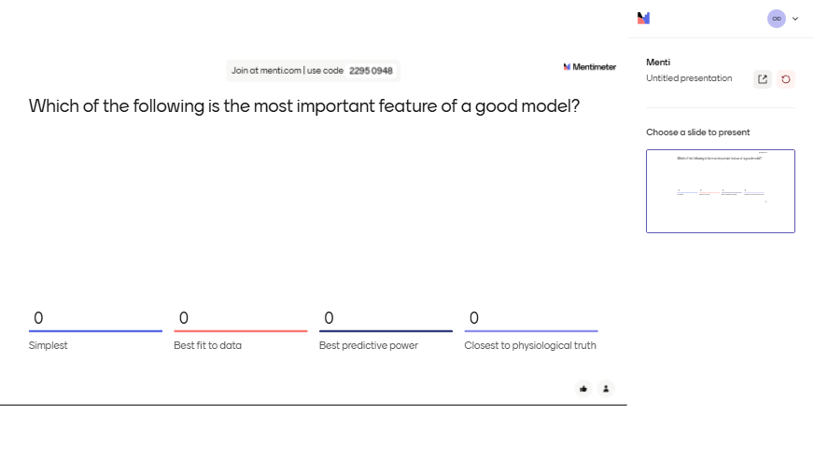
Quick quiz!

Slide 19
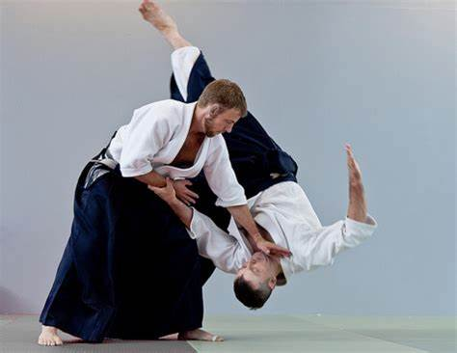
Where we are so far…
Why we study motor systems & motor learning
What models are & why we use them
Next: Foundational concepts & how the brain makes movement happen

Slide 20
Basic concepts
Feedforward and feedback control
Types of movement
Motor programs
Hierarchy

Slide 21
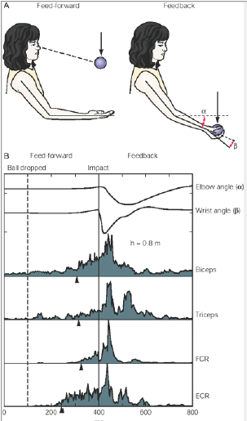
Feedforward and feedback control
Some movements anticipate what will happen
Some movements respond to what will happen
Kandel, Fig. 33-2

Slide 22
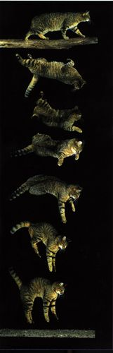
Types of movements
Reflexive movements
Stereotyped response
Same input always causes same output
Not completely under voluntary control
Often mediated through subcortical mechanisms

Slide 23
Types of movements
Reflexive
Rhythmic movement
Often governed by spinal central pattern generators
The movement serves as its own stimulus
Image in the public domain

Slide 24
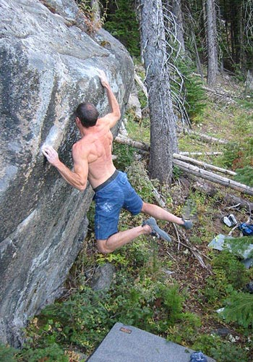
Types of movements
Reflexive
Rhythmic movement
Voluntary movements
Involve cortical or subcortical command centers
Often driven by internal motivation rather than a specific stimulus
Flexible
http://www.portlandrockgym.com/gfx/9.0_local_lrg.jpg

Slide 25
Types of movements
Summary table
Movement Type | Characteristics | Examples | Neural basis
Reflexive | Stereotyped, automatic, stimulus-driven | Knee-jerk reflex, withdrawal reflex | Spinal cord, subcortical
Rhythmic | Repetitive, often self-sustained | Walking, breathing | Central Pattern Generators (spinal cord, brainstem)
Voluntary | Flexible, goal-directed, often internally motivated | Reaching, writing, speaking | Cortical and subcortical motor areas

Slide 26
Basic concepts
Feedforward and feedback control
Types of movement
Motor programs
Hierarchy

Slide 27
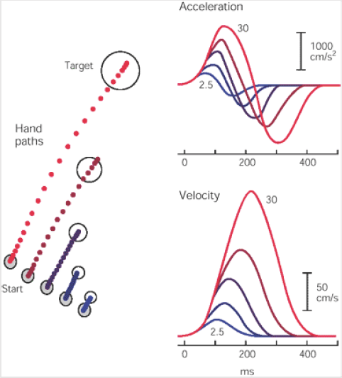
Motor programs
Movements are built out of building blocks that can be reused
In the figure
A basic motor pattern is scaled for different movement lengths

Slide 28
Hierarchy
‘Low level’
Simple control loops
Building blocks
Not flexible
Fast
‘Upper level’
Complex movements
Combined movements
Flexible and plastic
Slower

Slide 29
Basic concepts
Feedforward and feedback control
Types of movement
Motor programs
Hierarchy

Slide 30
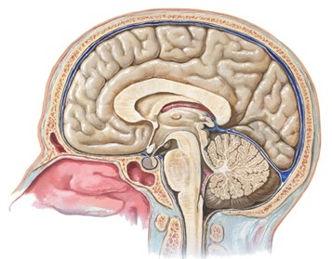
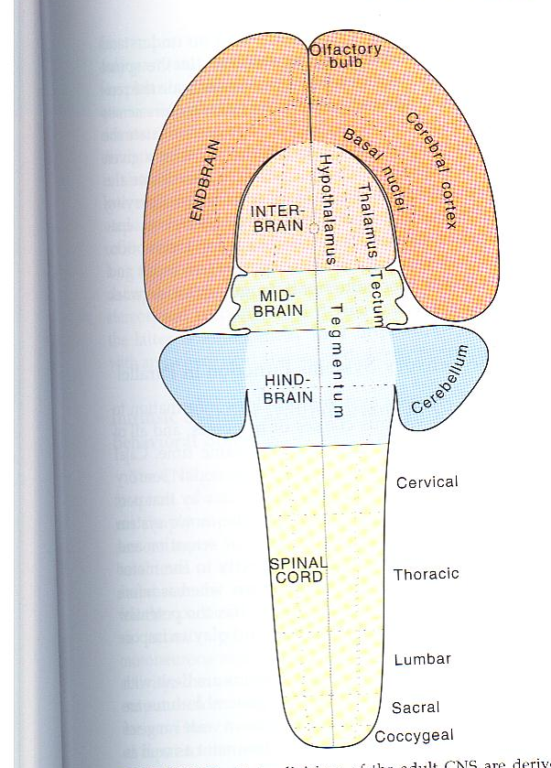
Overview of the Motor System
The motor system includes multiple interacting components.
Today: Broad overview
Details in later lectures.
Adult brain
Fetal neural tube
Cortex
Basal Ganglia
Cerebellum
Spinal cord

Slide 31
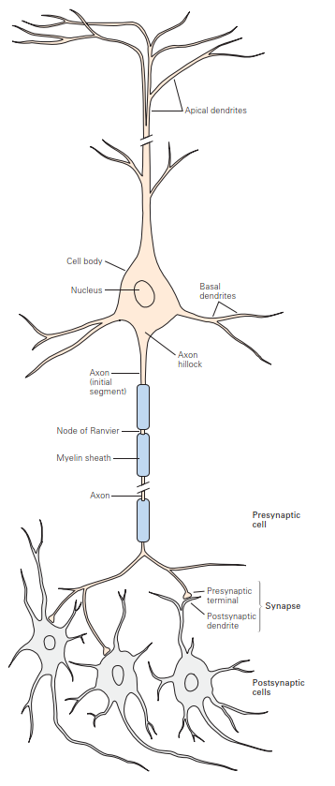
Neurons – The Building Blocks
Neurons transmit electrical signals.
Action potentials travel along axons to synapses.
Neurotransmitters transmit signals to the next neuron or muscle.

Slide 32
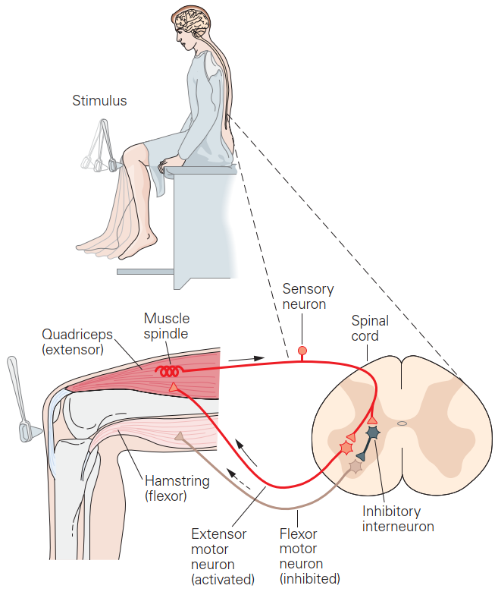
Sensation to action
Input signals go into the spinal cord on the axon of the “primary sensory afferent”
They go through a synapse to motor neurons
They go along the axon to the muscles

Slide 33
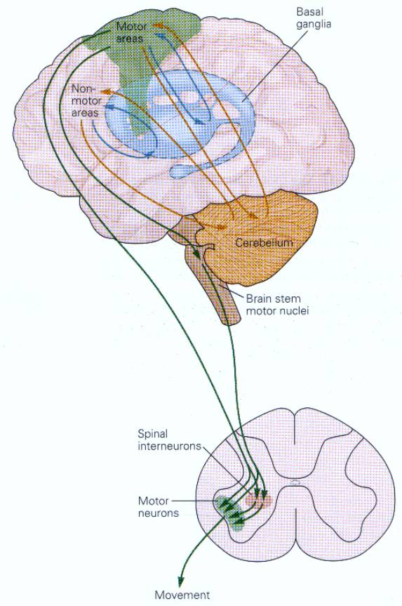
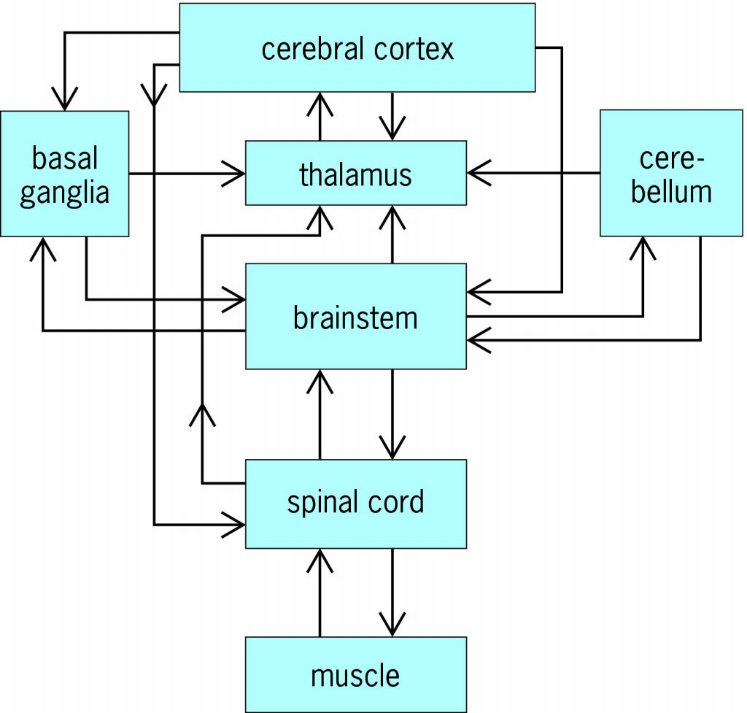
Motor Hierarchy
Top: Cortex (Planning movements)
Middle: Basal Ganglia, Cerebellum (Modulation, learning)
Bottom: Spinal Cord (Executing movement)
Different levels control different aspects of movement.

Slide 34
In-Class Exercise: Model an Arm Controller
What you’ll do
Write a controller that moves a simulated arm to a desired position
Arm is given: mass, damping and dynamics
Control two muscles: flexor and extensor

Slide 35
Rationale
Why bother
Realistic units
Practice designing
Exposure to core ideas
Inputs -> Models -> Outputs
Feedforward control strategy
Learning from simplified models

Slide 36
You Goal
Get to the target quickly and stably
Bonus points for turning in the assignment (0.4 points)
Extra bonus (0.2 points) for the best result
Open in class exercise in Google colab

